Slide 1
Why do we need statistics?

Slide 2
Curiosity and Questions about Social World
Why do Southerners have high rates of marriage?
Why is protest effective at raising public awareness?
Why do technological businesses yield larger profits than others?
Why do incumbent politicians follow public opinion?
Why do women CEOs make less money than male CEOs?
Why are blacks disproportionately targeted by police for nonviolent crimes?
Why are Latino/a/xs the subject of contemporary immigration debates?
Notes:
Questions about why the social world is the way it is…
“Why” questions/ or “under which conditions”/ or “what are the conditions under which” questions are general, and likely, answerable… In answering the questions, you should arrive at a “because A and B, and sometimes C” statement. You will also arrive at a ”how” statement.. About the processual nature of A, B, and C’s effects on the outcome. It is setting up a causal argument, for a causal process.

Slide 3
To answer these questions… requires

Slide 4
Data

Slide 5
Types of Data Analysis
Quantitative Methods
Developing and/or testing theories using numbers
Qualitative Methods
Developing and/or testing theories using language and/or actions
Interviews, conversations
Newspapers, articles, media broadcasts
Ethnography

Slide 6
Why Statistics/Quantitative Methods?
Helps us understand the world around us in an efficient way
Don’t have to interview every person
Provides a way to estimate how a person would respond if we did interview them
Allows us to predict/explain some outcome
Notes:
Based on probability theory… wherein we can predict/explain the likelihood of/get estimates of the pattern of relationships in the entire population (general theories) based on probability sampling…
If our sample characteristics matches characteristics in the population or a specific subpopulation, then we can make general claims about the relationship in the population.
Qualitative Methods can highlight variation and nuance in experiences/subjective interpretations of the relationship in the population… and we can TRY to infer (from our smaller sample of interviewees) something about the population… but these typically highlight extraordinary cases, or particulars of a subset of individuals… but doesn’t highlight the range of possible variation.
Qualitative Methods do, however, provide thick and rich descriptions of the processes by which people experience the relationship in question..... And provide insight into HOW to make sense of our general theories developed from large-scale quantitative analysis.

Slide 7
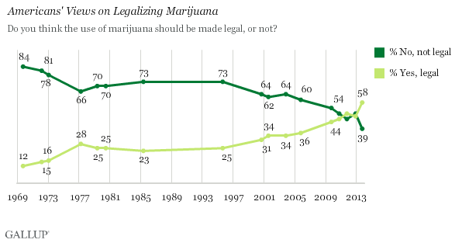
Example: Attitudes on Marijuana Legalization
Notes:
Say we're interested in how everyone the US views marijuana. It would be too time consuming to ask all Americans. To be more efficient, we just ask a subset (called a sample)... enough to include people who represent all walks of life in the US (called representativeness)... and create estimates of the US population's attitudes based on the responses of the sample. Because we can never be too certain that the responses of our sample FULLY reflect similar responses for all Americans, we add some uncertainty to our estimate (a measure called the deviation and relatedly, confidence interval).

Slide 8
The (Quantitative) Research Process

Slide 9
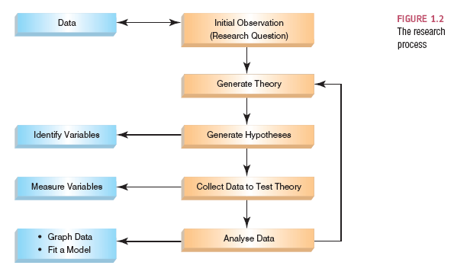
The Research Process

Slide 10
Initial Observation of Relationship
Observations or hunches about a relationship in the social world…
…From which you can derive a research question

Slide 11
Initial Observation of Relationship
You notice that many of your friends from the South are either already married or have been married for years
Notes:
From this, you develop a research question

Slide 12
Research Question
Why do Southerners have high rates of marriage?

Slide 13
What is the Purpose of the Research?
Exploratory
Mapping out a topic that may warrant further study later
Descriptive
Describing the state of social affairs
Explanatory
Providing reasons for phenomena, in terms of causal relationships
Notes:
Social research has several functions: can be exploratory, descriptive, or explanatory.
Exploratory – learning something new about a political group (lay research, non-publishable)
Descriptive – describes current situations like crime in cities, opinions on marijuana (reports from research firms, etc).
Explanatory – explains why a social phenomenon is occurring, using causal relationships, like why the employment rate is so high in a city. (high quality research)

Slide 14
What is the Purpose of the Research?
Exploratory
Mapping out a topic that may warrant further study later
Descriptive
Describing the state of social affairs
Explanatory
Providing reasons for phenomena, in terms of causal relationships
Notes:
Social research has several functions: can be exploratory, descriptive, or explanatory.
Exploratory – learning something new about a political group (lay research, non-publishable)
Descriptive – describes current situations like crime in cities, opinions on marijuana (reports from research firms, etc).
Explanatory – explains why a social phenomenon is occurring, using causal relationships, like why the employment rate is so high in a city. (high quality research)

Slide 15
Explanatory Research
Empirical
Aims for explaining underlying causal processes (causation)

Slide 16
Empirical Research: Causation Defined
Correlation/Association
The presence of a statistical association between the cause and the effect
Time Ordering
The cause must precede the effect
Absence of Spuriousness
The association between the cause and the effect cannot be explained by a third variable/cause
Spurious Relationships and Confounding Variables
A variable (that we may or may not have measured) other than the predictor variables that potentially affects an outcome variable.
The relationship between breast implants and suicide is confounded by self esteem.
Ruling out confounds, control for/include those variables

Slide 17
The Research Process

Slide 18
Generating Theories and Hypotheses about Relationship
Theory
A set of principles that explain a relationship
Hypothesis
A prediction from a theory.
Notes:
Falsification
The act of disproving a theory or hypothesis.

Slide 19
Theory
People from the South are more likely to be embedded in social institutions that pressure marriage (or discourage premarital sex).
e.g. churches

Slide 20
Hypothesis
The percent of married Southerners who are churchgoers will be higher than the percent of churchgoers in the general population

Slide 21
Variables in the Relationship
Variables
Things that vary (change)
Notes:
Research Questions

Slide 22
Variables
Independent Variable
Cause
Predictor
Dependent Variable
Effect
Outcome

Slide 23
Variables
Church Attendance
Marital Status

Slide 24
Variables
Church Attendance
Predictor, Independent Variable
Marital Status
Outcome, Dependent Variable

Slide 25
The Research Process

Slide 26
What Kind of Question is This?
Is the question about a static or ``as it currently stands” relationship?
Cross-sectional
Is it a question about a relationship that unfolds over time?
Longitudinal

Slide 27
Types of Data
Cross-sectional data (between-subjects)
Data from many different elements (e.g. people, counties, states) at a single point in time, a cross-section of the population
Longitudinal data (within-subjects)
Data from many of the same elements (e.g. people, counties, states) at multiple time points

Slide 28
Measurement of Variables

Slide 29
Levels of Measurement
Nominal
Ordinal
Interval
Ratio

Slide 30
Levels of Measurement
Nominal
Variables whose attributes have only the characteristics of exhaustiveness and mutually exclusiveness. Simple categories. Attributes that classify, but cannot be ranked!
Examples: gender, religious affiliation, college major, hair color, birthplace, nationality, party affiliation
Binary/Dichotomous
special case of nominal variable with only two values
Example: voter/non-voter, yes/no

Slide 31
Levels of Measurement
Ordinal
Variables with attributes we can logically rank order. Variables whose attributes that classify and can be ranked but lack an associated numerical value.
Examples: socioeconomic status, level of conflict, prejudice, conservativeness, hardness

Slide 32
Levels of Measurement
Interval
Variables for which the actual distance between attributes has meaning. Variables whose attributes classify, can be ranked ordered, and have an equal numerical distance between values.
Examples: temperature (Fahrenheit), IQ score

Slide 33
Levels of Measurement
Ratio
Variables whose attributes meet the requirements of a interval measure, and has a true zero point.
Examples: temperature (Kelvin), age, length of time, number of organizations, number of groups, number of A’s received in college
Notes:
Mostly, people in social science call interval variables “interval-ratio” variables.

Slide 34
Exercise: Levels of Measurement
Church Attendance
Nominal
Ordinal
Interval-Ratio
Marital Status
Nominal
Ordinal
Interval-Ratio

Slide 35
The Research Process

Slide 36
Analyzing Data: Univariate Measures
Measures of Central Tendency
Measures of Dispersion

Slide 37
Measures of Central Tendency
Mode
The most frequently observed value or attribute. Can be used for all variable types: nominal, ordinal, and interval.
Median
The value of the “middle” case in a rank-ordered set of observations. Should only be used for two variable types: ordinal, and interval.
Mean
Center/average score, computed by summing the values of several observations and dividing by the number of observations. Should only be used for interval variables

Slide 38
The Mode
Mode
The most frequent score
Bimodal
Having two modes
Multimodal
Having several modes

Slide 39
The Median
The Median is the middle score when scores are ordered:

Slide 40
The Mean
Mean
The sum of scores divided by the number of scores.
Example: Number of friends of 11 Facebook users.

Slide 41
Measures of Dispersion
Range
Interquartile Range
Variance
Standard Deviation

Slide 42
Range
The Range
The smallest score subtracted from the largest
Example: For our Facebook friends data the highest score is 234 and the lowest is 22; therefore the range is: 234 −22 = 212

Slide 43
The Interquartile range
Quartiles
The three values that split the sorted data into four equal parts.
Second Quartile = median.
Lower quartile = median of lower half of the data
Upper quartile = median of upper half of the data

Slide 44
Pre-Variance: Deviation/Deviance
We can calculate the spread of scores by looking at how different each score is from the center of a distribution e.g. the mean:

Slide 45
Variance
Indicates the total dispersion, or total deviance of scores from the mean:
It’s size is dependent on the number of scores in the data.
More useful to work with the average dispersion, known as the variance:

Slide 46
Standard Deviation
The variance gives us a measure in units squared.
Example: In our Facebook example we would have to say that the average error in out data was 3224.6 friends squared.
This problem is solved by taking the square root of the variance, which is known as the standard deviation:

Slide 47
Example: Same Mean, Different SD

Slide 48
Graphing Data: Histograms
Frequency Distributions (aka Histograms)
A graph plotting values of observations on the horizontal axis, with a bar showing how many times each value occurred in the data set.

Slide 49
Graphing Data: Histograms
The ‘Normal’ Distribution
Bell shaped
Symmetrical around the center

Slide 50
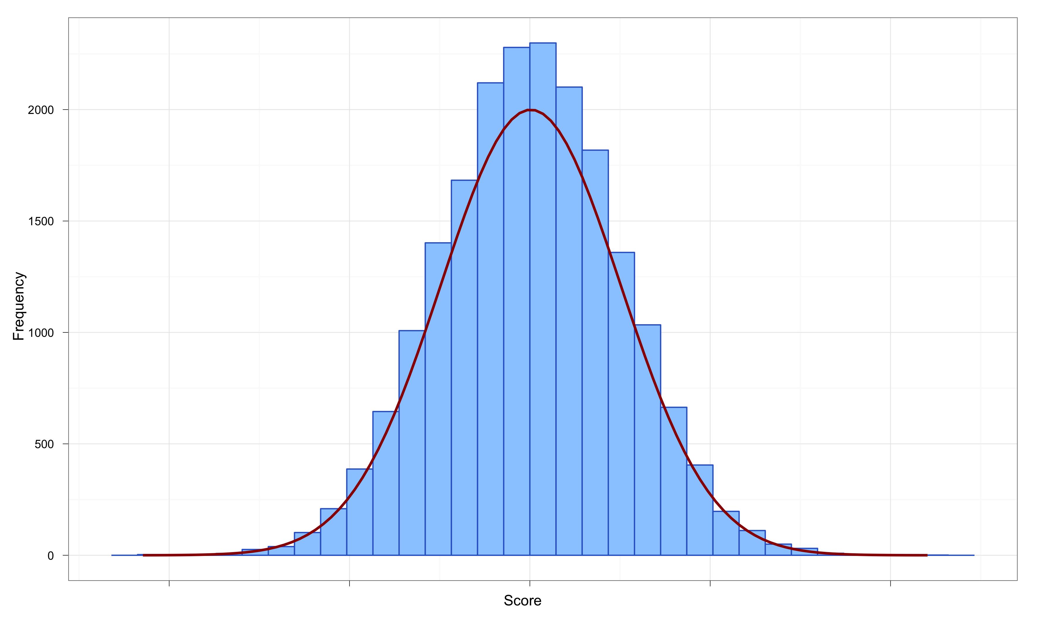
The Normal Distribution

Slide 51
Properties of Frequency Distributions
Skew
The symmetry of the distribution.
Positive skew (scores bunched at low values with the tail pointing to high values).
Negative skew (scores bunched at high values with the tail pointing to low values).
Kurtosis
The ‘heaviness’ of the tails.
Leptokurtic = heavy tails and pointy around center.
Platykurtic = light tails and flat.

Slide 52
Skew

Slide 53
Kurtosis

Slide 54
Bimodal and Multimodal Distributions

Slide 55
Same Mean, Different SD

Slide 56
Measurement Considerations

Slide 57
Reliability and Validity
Reliability
The ability of the measure to produce the same results under the same conditions.
Validity
Whether an instrument measures what it set out to measure.
An instrument (e.g. a psychological inventory) cannot be valid without first being reliable

Slide 58
Measurement Error
Measurement error
The discrepancy between the actual value we’re trying to measure, and the number we use to represent that value.
Example:
You (in reality) weigh 80 kg.
You stand on your bathroom scales and they say 83 kg.
The measurement error is 3 kg.

Slide 59
Types of Variation
Systematic Variation
Differences in performance created by a specific experimental manipulation.
Unsystematic Variation
Differences in performance created by unknown factors.
Age, Gender, IQ, Time of day, Measurement error etc.

Slide 60
Probability Distributions

Slide 61
The Normal Probability Distribution

Slide 62
Going beyond the data: Z-scores
Z-scores
Standardising a score with respect to the other scores in the group.
Expresses a score in terms of how many standard deviations it is away from the mean.
The distribution of z-scores has a mean of 0 and SD = 1.

Slide 63
Properties of z-scores
1.96 cuts off the top 2.5% of the distribution.
−1.96 cuts off the bottom 2.5% of the distribution.
As such, 95% of z-scores lie between −1.96 and 1.96.
99% of z-scores lie between −2.58 and 2.58,
99.9% of them lie between −3.29 and 3.29.

Slide 64
Probability Density function of a Normal Distribution

